Slide 1
CULINARY CALENDAR
2021
Erasmus+ project ”Europe on seven hills”
2018 - 1 - RO01 - KA229 - 049484
12 Traditional dishes
The European Commission support for the production of this publication does not constitute an endorsement of the contents which reflects the views only of the authors, and the National Agency and Commission cannot be held responsible for any use which may be made of the information contained therein.

Slide 2
JANUARY 2021
S U N | MON | T U E | W E D | T H U | F R I | S A T
 |  |  |  |  | 1 | 2
3 | 4 | 5 | 6 | 7 | 8 | 9
10 | 11 | 12 | 13 | 14 | 15 | 16
17 | 18 | 19 | 20 | 21 | 22 | 23
24 | 25 | 26 | 27 | 28 | 29 | 30
D
O
L
M A
Ingredients :
- parsley - onion
- bell pepper - tomato paste
- rice - dried mint
- tomatoes
31

Slide 3
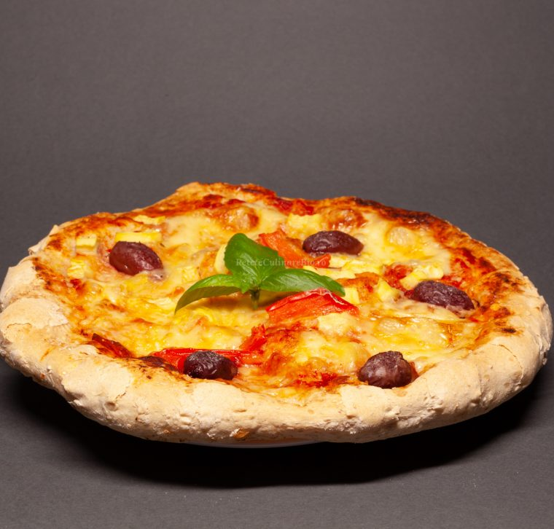
FEBRUARY 2021
S U N | M O N | T U R | W E D | T H U | F R I | S A T
 | 1 | 2 | 3 | 4 | 5 | 6
7 | 8 | 9 | 10 | 11 | 12 | 13
14 | 15 | 16 | 17 | 18 | 19 | 20
21 | 22 | 23 | 24 | 25 | 26 | 27
28
P
I
Z
Z
A
Ingredients :
-400g of flour , 25g of yeast , 2 tablespoons sweet milk , 75 ml oil , 2 tablespoons yogurt , 50ml of mineral water
For topping :
-300g cheese , 200g olives , 2 pepper, salt , 1-2 tomatoes , a red onion , 2 parsley threads , 250g spicy and dry salami , sweet and spicy tomato sauce , thyme

Slide 4
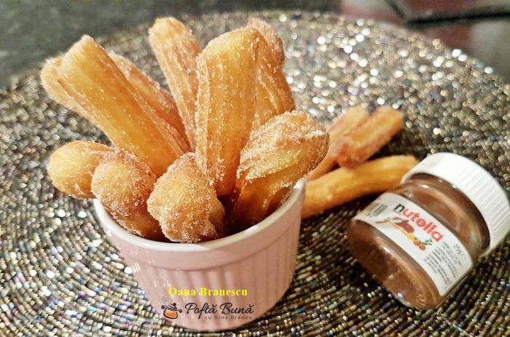
MARCH 2021
S U N | MON | T U E | W E D | T H U | F R I | S A T
 | 1 | 2 | 3 | 4 | 5 | 6
7 | 8 | 9 | 10 | 11 | 12 | 13
14 | 15 | 16 | 17 | 18 | 19 | 20
21 | 22 | 23 | 24 | 25 | 26 | 27
28 | 29 | 30 | 31
C
H
U
R
R
O
S
Ingredients :
-250ml water , 60g butter , 35g sugar , 200g flour , 2 eggs , vanilla paste or essence , a pinch of salt
For frying :
-300 ml oil
For powdering :
-sugar , cinnamon

Slide 5
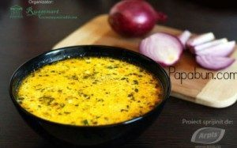
APRIL 2021
D
R
E
S
A
L
A
S U N | M O N | T U E | W E D | T H U | F R I | S A T
 |  |  |  | 1 | 2 | 3
4 | 5 | 6 | 7 | 8 | 9 | 10
11 | 12 | 13 | 14 | 15 | 16 | 17
18 | 19 | 20 | 21 | 22 | 23 | 24
25 | 26 | 27 | 28 | 29 | 30
INGREDIENTS :
- 2 potatoes
- 3 carrots
- 3 white onions
- 2 bell peppers
- 500 g sour cream
- olive oil
- 2 eggs
- whipped milk
- 2 l water
- vermicelli
- salt
- pepper

Slide 6
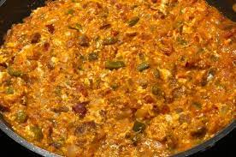
MAY 2021
SUN | MON | TUE | WED | THU | FR I | SAT
 |  |  |  |  |  | 1
2 | 3 | 4 | 5 | 6 | 7 | 8
9 | 10 | 11 | 12 | 13 | 14 | 15
16 | 17 | 18 | 19 | 20 | 21 | 22
23 | 24 | 25 | 26 | 27 | 28 | 29
30 | 31
M
E
N
E
M
E
N
INGREDIENTS
-3 eggs , 2 tablespoons oil , 1 diced onion , 1/2 green bell pepper , 1/2 yellow bell pepper , 3 tomatoes , 1/2 teaspoon salt, freshly ground pepper , oregano powder

Slide 7
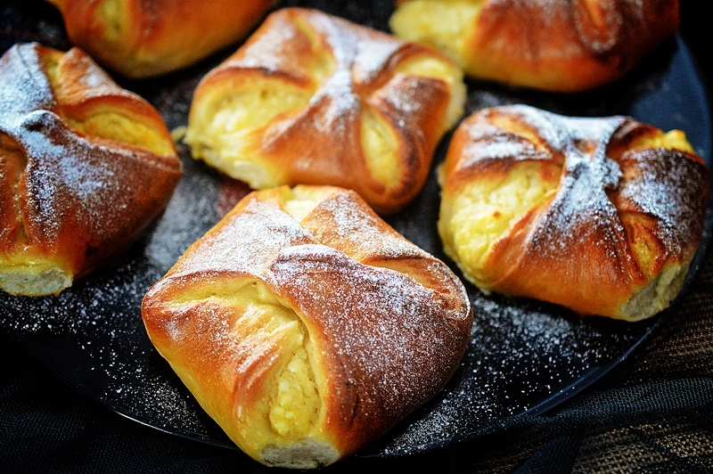
JUNE 2021
S UN | MON | T U E | W E D | T HU | F R I | S A T
 |  | 1 | 2 | 3 | 4 | 5
6 | 7 | 8 | 9 | 10 | 11 | 12
13 | 14 | 15 | 16 | 17 | 18 | 19
20 | 21 | 22 | 23 | 24 | 25 | 26
27 | 28 | 29 | 30
P
O
A
L
E
-
N
B
R
Â
U
INGREDIENTS :
For the dough:
▢ 550 g flour
▢ 300 ml of warm milk
▢ 60 g sugar
▢ 50 g butter
▢ 10 g dry yeast
▢ 2 yolks
▢ lemon peel
▢ a little salt
For the filling:
▢ 150 g raisins
▢ 500 g sweet cottage cheese
▢ 70 g sugar
▢ 2 eggs
▢ vanilla
▢ lemon peel

Slide 8
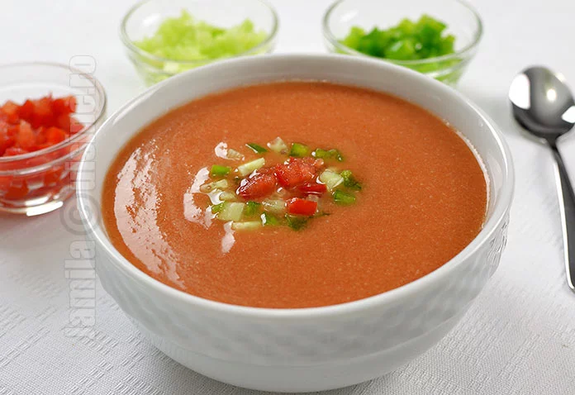
JULY 2021
S U N | MO N | T U E | W E D | T H U | F R I | S A T
 |  |  |  | 1 | 2 | 3
4 | 5 | 6 | 7 | 8 | 9 | 10
11 | 12 | 13 | 14 | 15 | 16 | 17
18 | 19 | 20 | 21 | 22 | 23 | 24
25 | 26 | 27 | 28 | 29 | 30 | 31
G
A
Z
P
A
C
H
O
Ingredients:
▢ 3 cucumbers
▢ 2 slices of bread
▢ 2 tablespoons vinegar
▢ 1 kg tomatoes
▢ 1/2 green bell pepper
▢ 1/4 onion
▢ 1 cup water
▢ 1 clove of garlic
▢ 1 teaspoon salt
▢ 50 ml oil

Slide 9
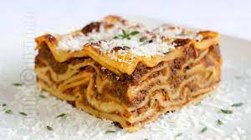
AUGUST 2021
S U N | MO N | T U E | W E D | T HU | F R I | S A T
1 | 2 | 3 | 4 | 5 | 6 | 7
8 | 9 | 10 | 11 | 12 | 13 | 14
15 | 16 | 17 | 18 | 19 | 20 | 21
22 | 23 | 24 | 25 | 26 | 27 | 28
29 | 30 | 31
L
A
S
A
G
N
A
INGREDIENTS
For bolognese sauce: ▢ 1 kg of minced beef ▢ 1 kg mashed tomatoes ▢ 3-4 tablespoons oil ▢ 2 tablespoons tomato paste ▢ 2 carrots ▢ 2 onions ▢ 2 bay leaves ▢ 3 cloves of garlic ▢ a little rosemary ▢ a little thyme ▢ Italian herbs ▢ salt ▢ pepper
For bechamel sauce: ▢ 700 ml milk ▢ 70 g flour ▢ 70 g butter ▢ 1 bay leaf ▢ a little thyme ▢ nutmeg ▢ pepper ▢ salt
For assembly: ▢ 200 g mozzarella ▢ 100 g parmesan ▢ lasagna noodles

Slide 10
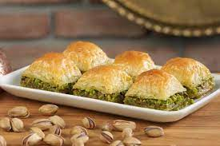
SEPTEMBER 2021
B
A
K
L
A
V
A
Ingredients (14 servings)
- 300 g almonds
- 300 g pistachios
- 400 g sugar
- 400 ml of water
- 100 g butter
- 1 pack of pie dough
- vanilla essence
SUN | MON | TUES | WED | THU | FRI | SAT
 |  |  | 1 | 2 | 3 | 4
5 | 6 | 7 | 8 | 9 | 10 | 11
12 | 13 | 14 | 15 | 16 | 17 | 18
19 | 20 | 21 | 22 | 23 | 24 | 25
26 | 27 | 28 | 29 | 30

Slide 11
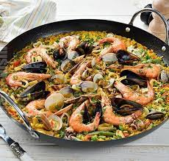
OCTOBER 2021
P
A
E
L
L
A
S U N | MO N | T U E | W E D | T H U | F R I | S A T
 |  |  |  |  | 1 | 2
3 | 4 | 5 | 6 | 7 | 8 | 9
10 | 11 | 12 | 13 | 14 | 15 | 16
17 | 18 | 19 | 20 | 21 | 22 | 23
24 | 25 | 26 | 27 | 28 | 29 | 30
INGREDIENTS:
▢ 1 green bell pepper ▢ 350 g of rice ▢ 300 g chicken breast ▢ 1 red bell pepper ▢ 150 g frozen peas ▢ 150 g frozen green beans ▢ 2 finely chopped tomatoes ▢ parsley ▢ 4-5 tablespoons olive oil ▢ 3 cloves of garlic ▢ 300 g shrimp ▢ 500 ml vegetable soup ▢ 500 g mussels ▢ 300 g squid ▢ 1 teaspoon sweet paprika ▢ 1/2 teaspoon sofran ▢ salt
31

Slide 12
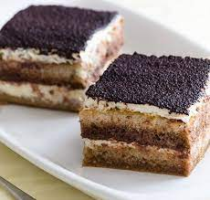
NOVEMBER 2021
S U N | MO N | T U E | W E D | T H U | F R I | S A T
 | 1 | 2 | 3 | 4 | 5 | 6
7 | 8 | 9 | 10 | 11 | 12 | 13
14 | 15 | 16 | 17 | 18 | 19 | 20
21 | 22 | 23 | 24 | 25 | 26 | 27
28 | 29 | 30
T
I
R
A
M
I
S
U
INGREDIENTS:
▢ 500 g mascarpone ▢ 500 ml sweetened coffee ▢ 400 g biscuits ▢ 8 tablespoons sugar ▢ 5 separate eggs ▢ 3 tablespoons cocoa ▢ vanilla essence ▢ a pinch of salt

Slide 13
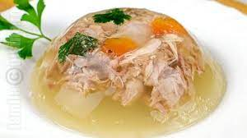
DECEMBER 2021
P
I
F
T
I
E
INGREDIENTS:
1,5 kg pork meat, 1,5 kg turkey meat, 1 clove of garlic, 1 carrot, parsley, 1 celery, an onion, salt, 1 pack of colorless gelatin.
SUN | MON | TUES | WED | THURS | FRI | SAT
 |  |  | 1 | 2 | 3 | 4
5 | 6 | 7 | 8 | 9 | 10 | 11
12 | 13 | 14 | 15 | 16 | 17 | 18
19 | 20 | 21 | 22 | 23 | 24 | 25
26 | 27 | 28 | 29 | 30 | 31

Slide 14
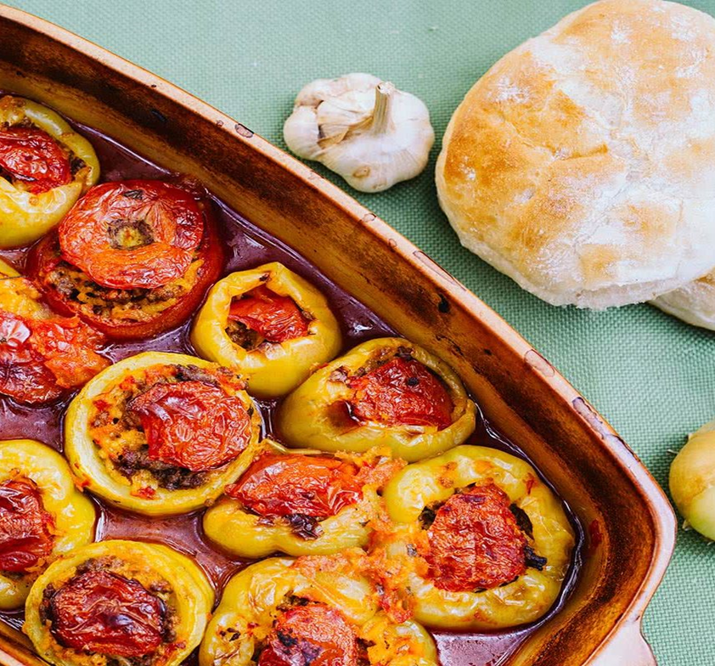
-POFTĂ BUNĂ!
-AFİYET OLSUN!
-BUEN APETITO!
-LUSSURIA BUNQ!

