Slide 1
Let’s act!
Civilised behaviour on 7 Hills
14th November 2019
Notes:
1. (cyber)Bullying
2. Homophobia
3. Gender violence
4. Racial violence
5. Drug abuse

Slide 2
Getting ready
Spread out in groups of 5
Minimum 3 nationalities per group

Slide 3
15’
Let’s focus & be creative
Draw a situation related to your topic

Slide 4
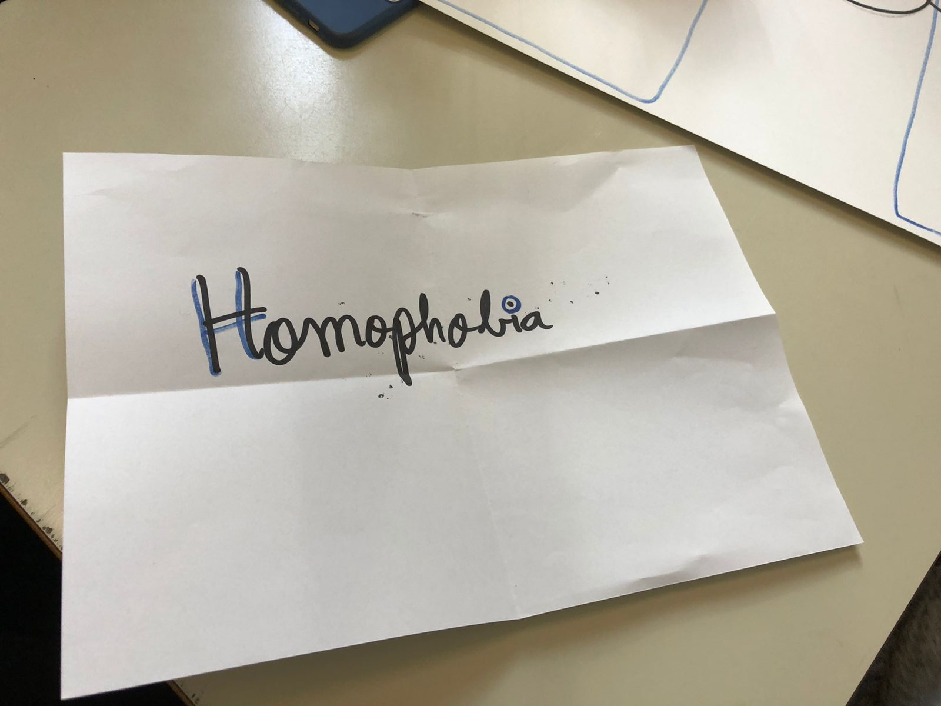
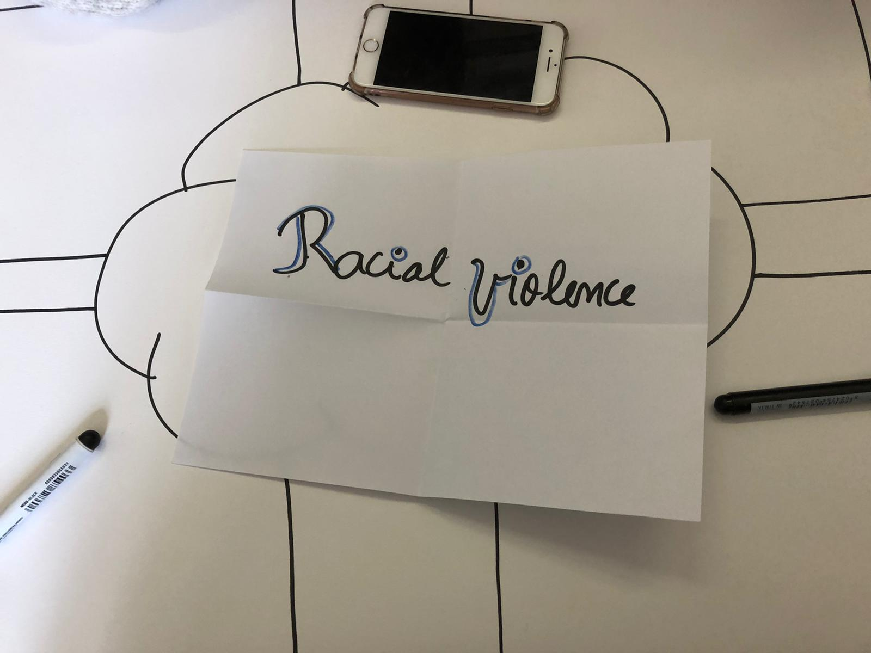
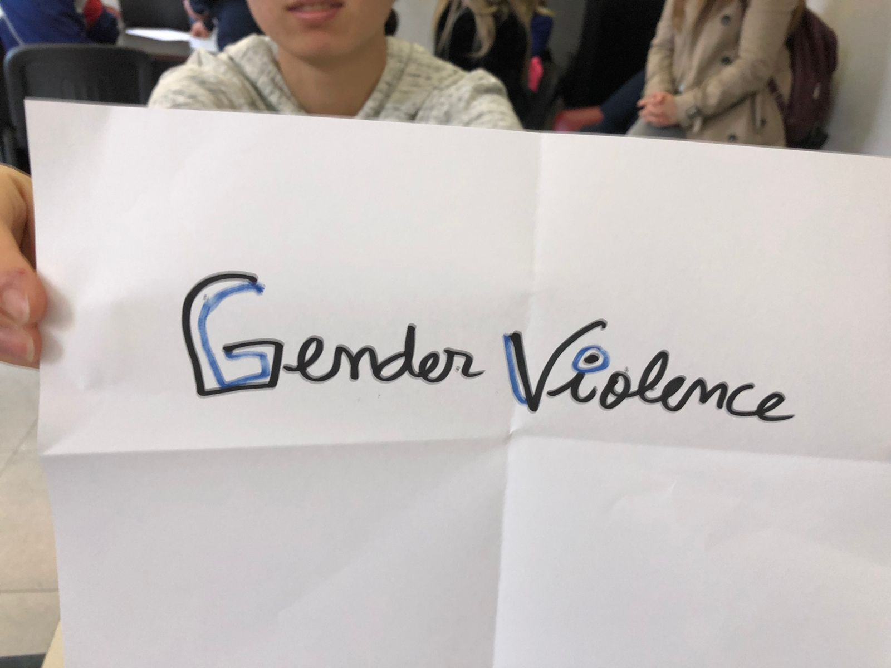
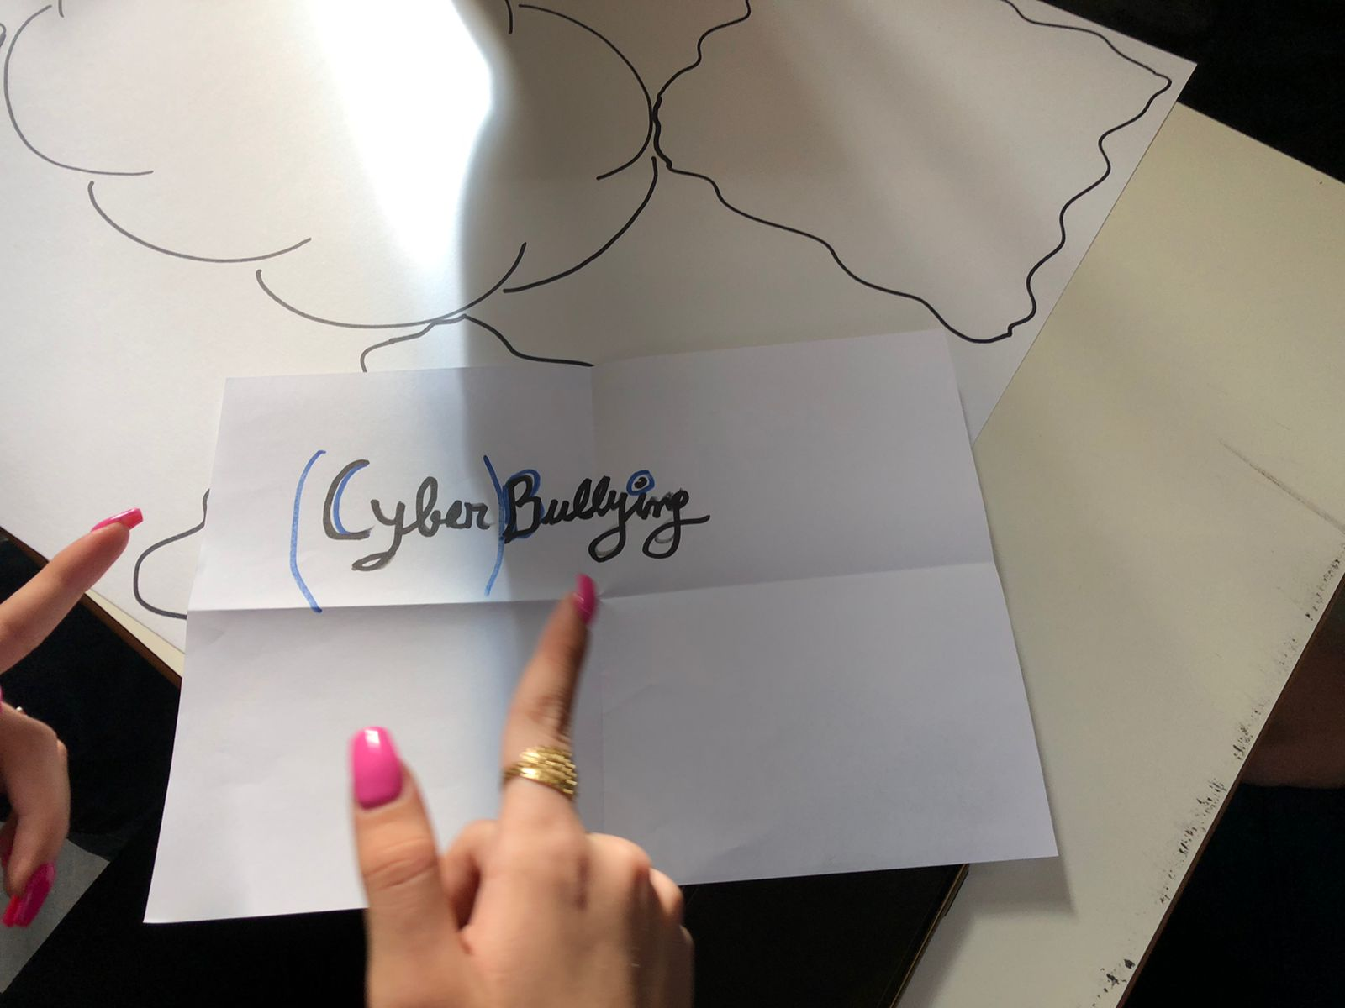
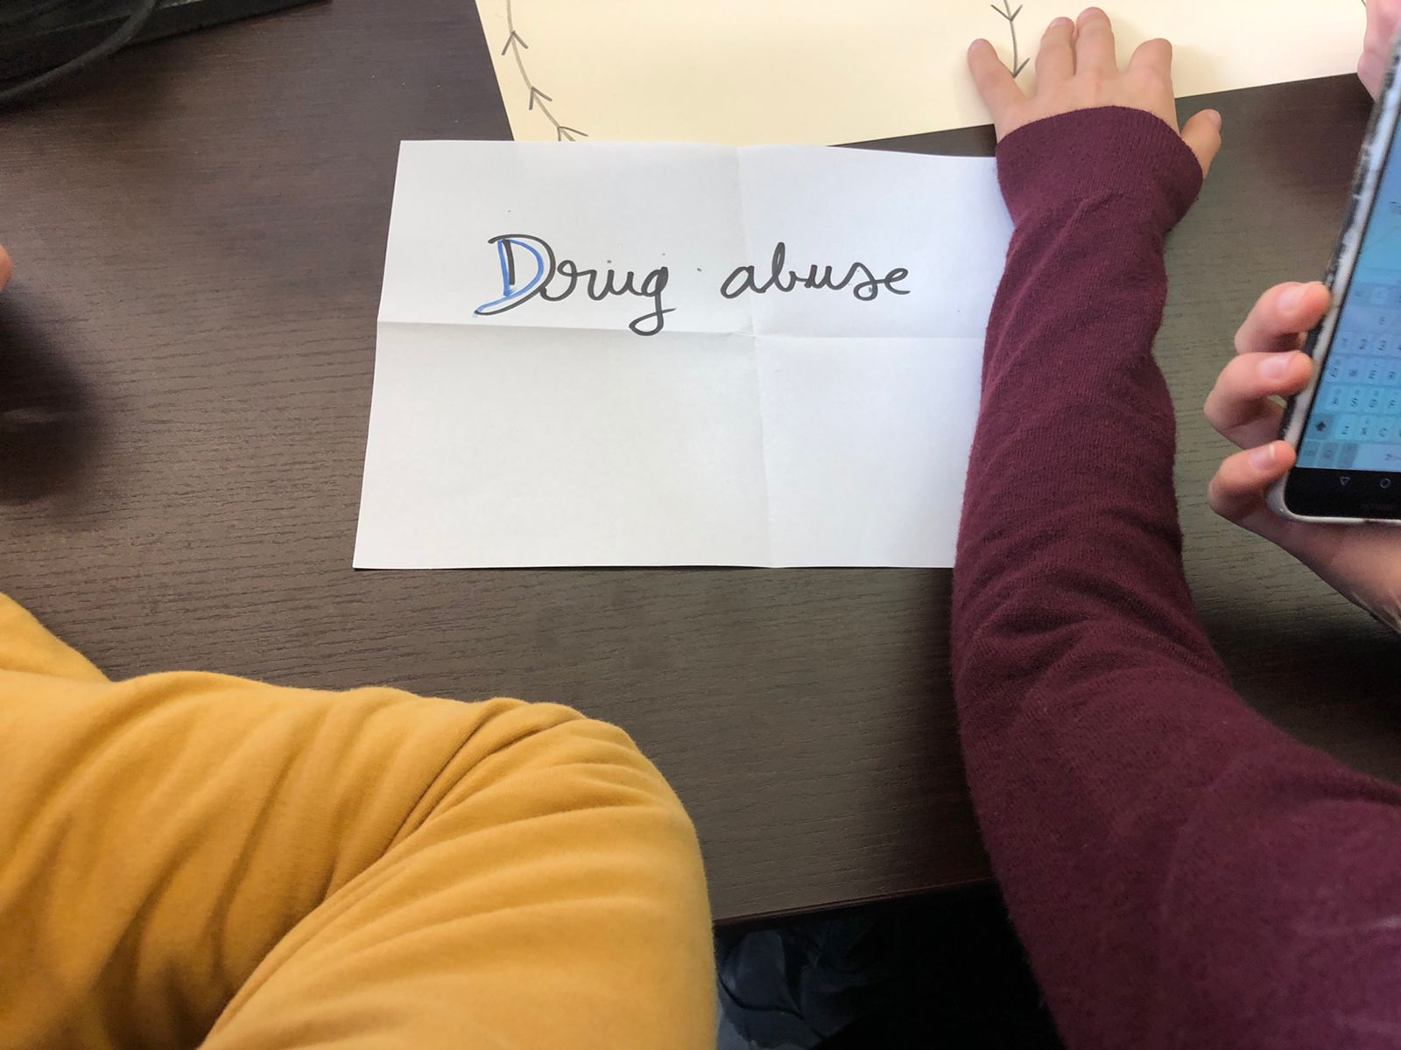

Slide 5
15’
Let’s identify the causes
List possible reasons

Slide 6
15’
Time to guess the consequences
(for the victim)
List possible consequences

Slide 7
15’
What can you do?
List possible actions you can carry out to solve the situation

Slide 8
15’
What can the school do?
List possible actions your school can carry out to solve the situation

Slide 9
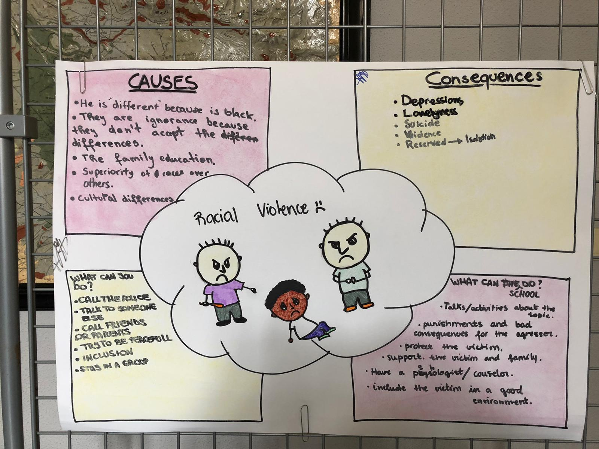

Slide 10
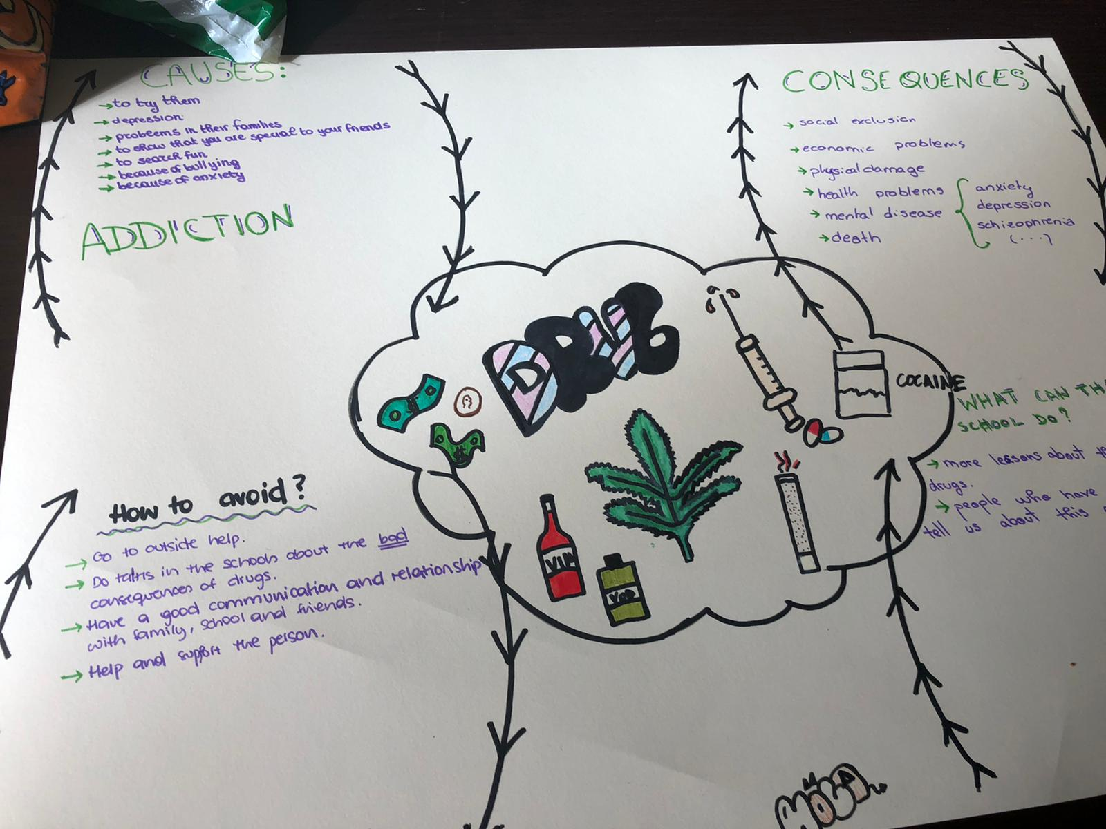

Slide 11
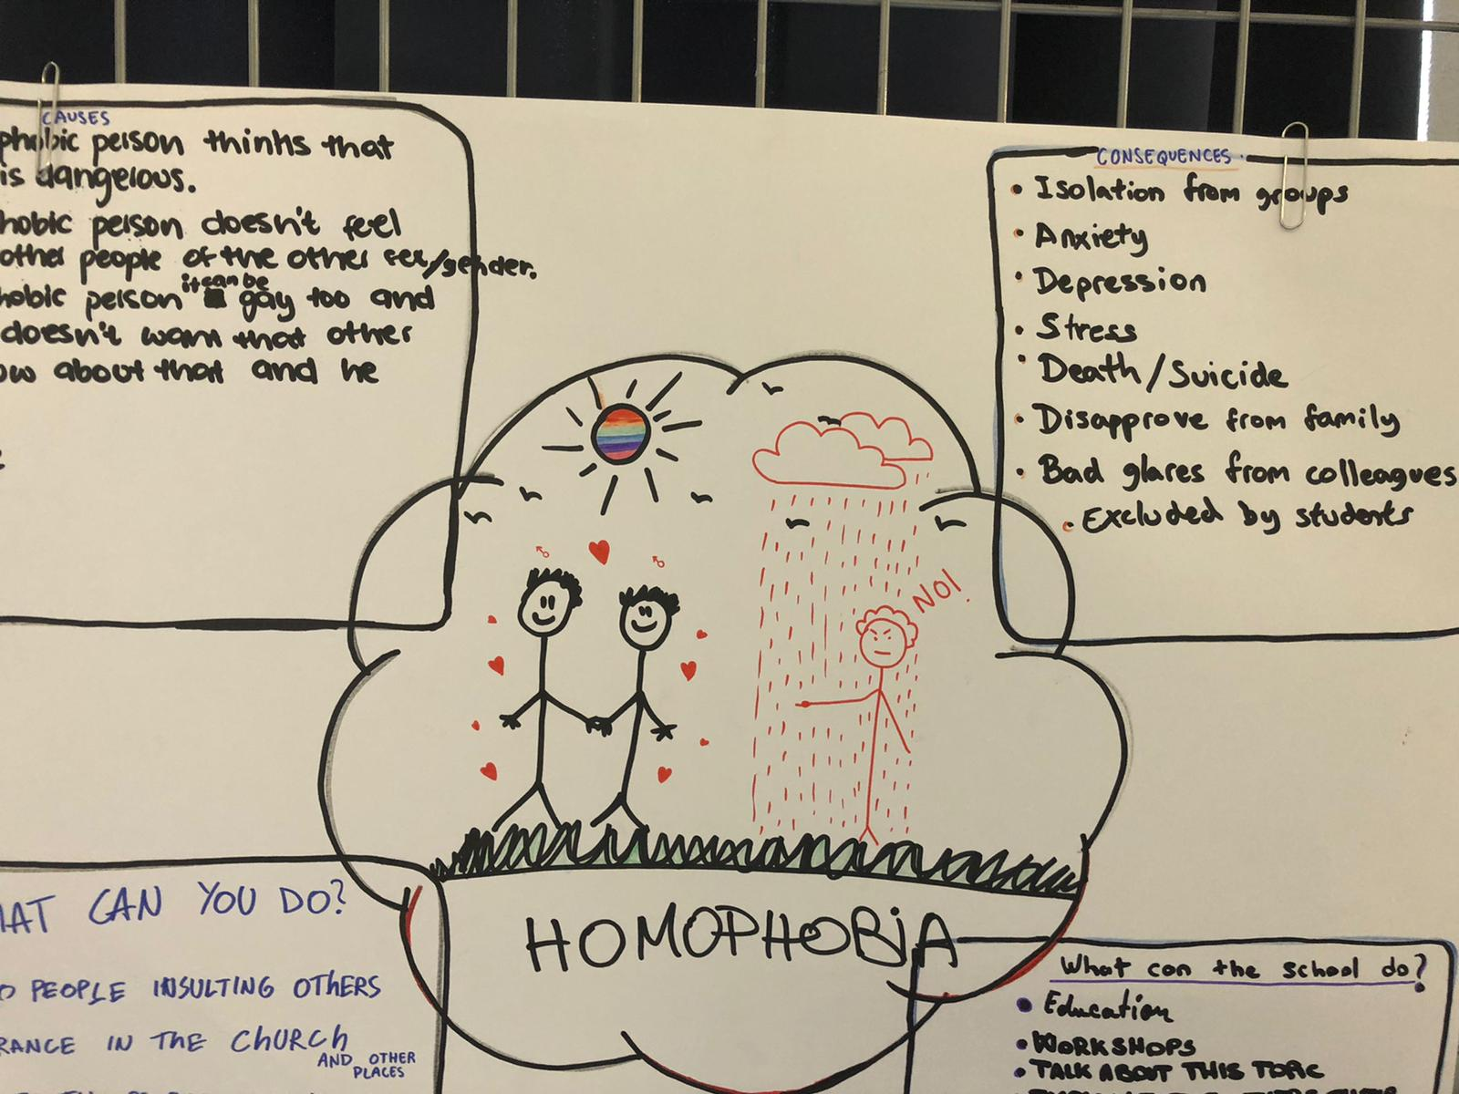

Slide 12
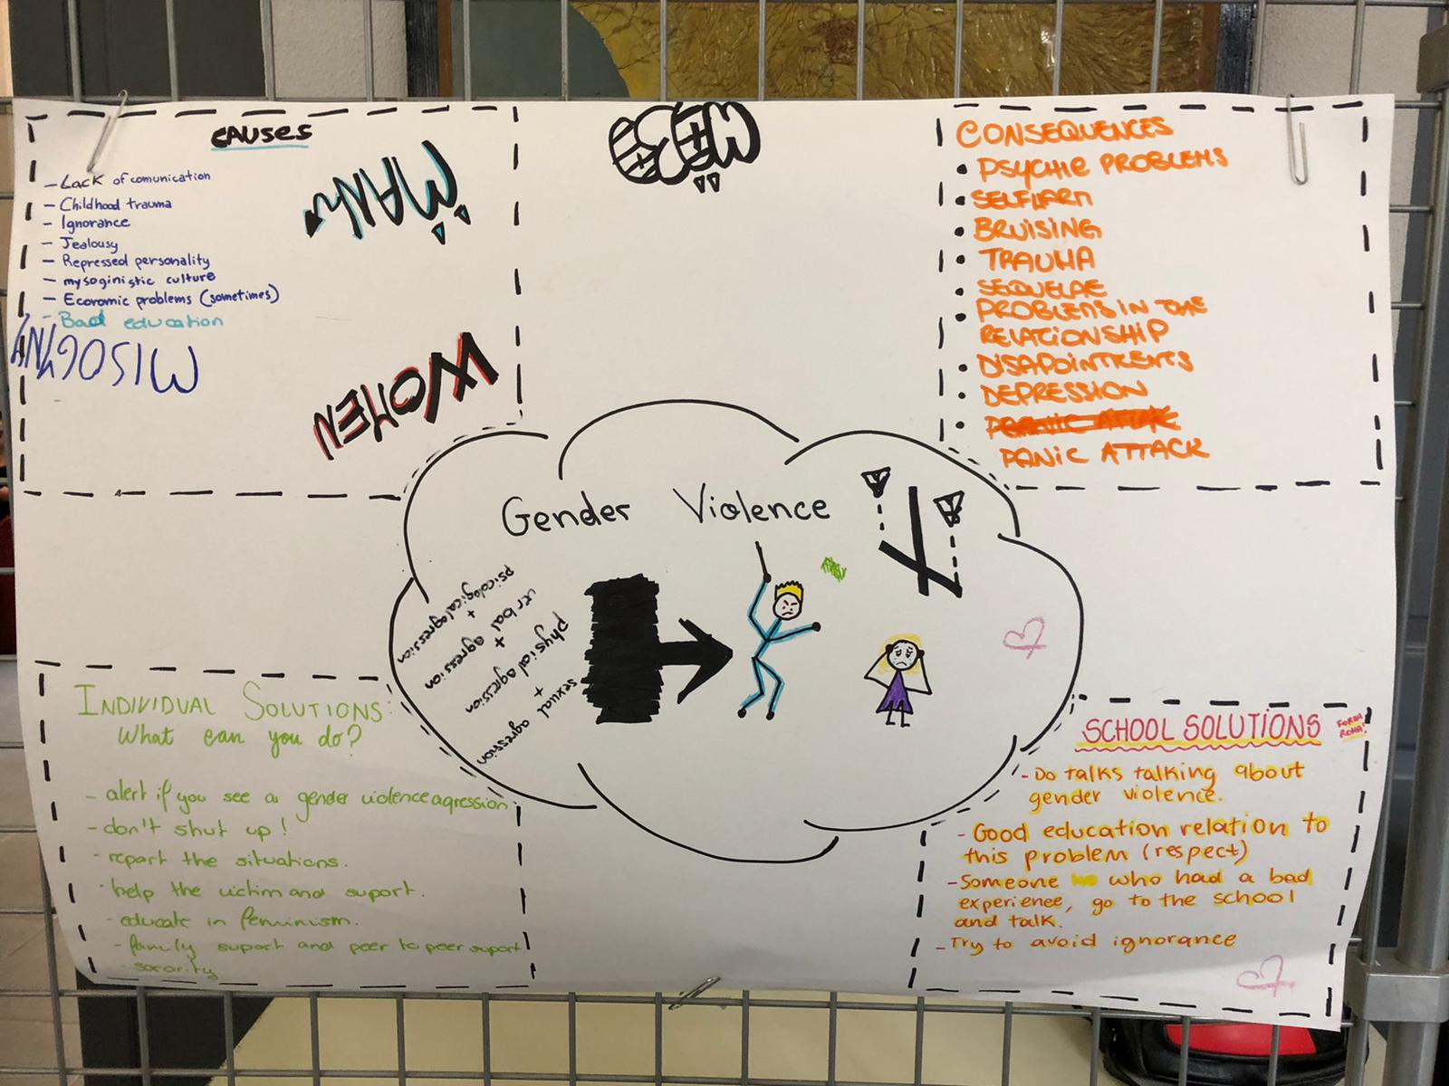

Slide 13
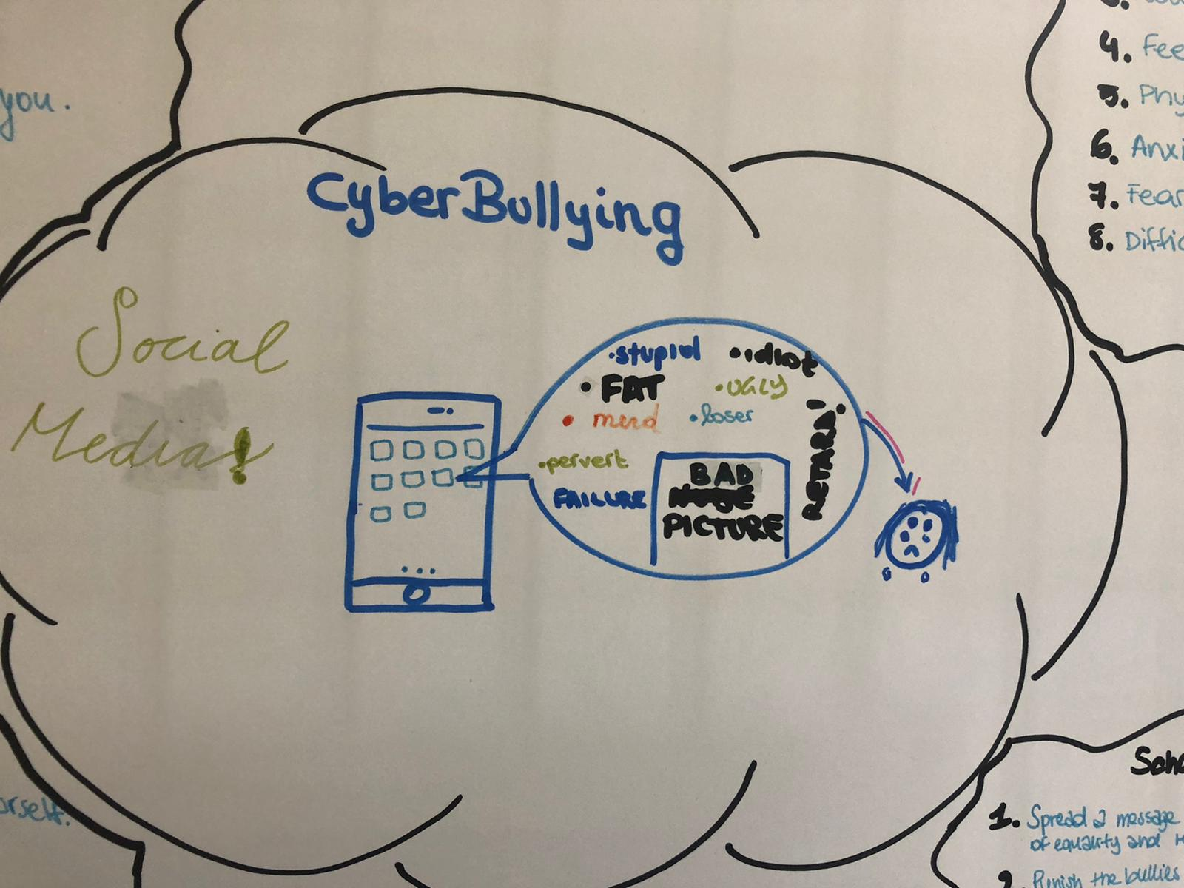

Slide 14
30’
Show us how !!
Prepare a short video showing the attitudes and attributes we should have to avoid these kind of situations
Be creative and use a metaphor

Slide 15
Short videos with attitudes and attributes
DRUGS ABUSE - https://www.youtube.com/watch?v=JWTSTastHLA
Homphobia - https://www.youtube.com/watch?v=XmZuSpOrp-k
RACISM - https://www.youtube.com/watch?v=03F7krrRRjM
Gender VIOLENCE https://www.youtube.com/watch?v=Zbo55ui7C-o
Cyberbullying https://www.youtube.com/watch?v=gVe7v49p7iE

